Slide 1


Slide 2


MEET THE PRESENTERS
MBA, Principal
CPA, CCIFP, Accounting Manager
Teresa Petrie
Alex Barrett
Perkins & Co
Barrett & Co
EMAIL
EMAIL
tpetrie@perkinsaccounting.com
alex@barrett-cpa.com
PHONE
PHONE
#503.276.1487
#360.210.5100

Slide 3
Agenda
1
2
Foundational Accounting Basics
Profit vs Cash and the ‘S’ Curves of Cash Flow
3
4
Understanding Your Working Capital
Preparing for Outside Eyes on Your Financials
5
6
Public Works, Industry, and State Requirements
Considerations for Accurate Estimating and Bidding
7
8
Monitoring Financial Results
Building Your Advisory Team

Slide 4
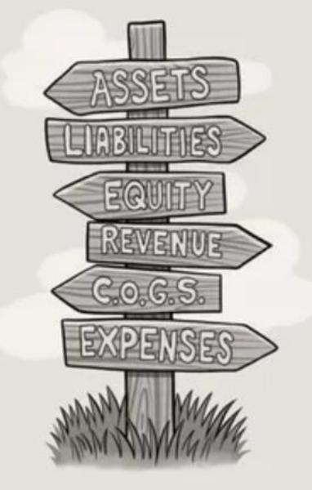
ACCOUNTING PRINCIPLES: PREPARING FOR GOVERNMENT CONTRACTING
Chart of Accounts Structure
A complete listing of all the accounts in the company
Used for recording and classifying transactions
The framework which supports the Balance Sheet and the Income Statement
A tool to quickly identify Direct vs Indirect Costs
Supports useful trend analysis

Slide 5

ACCOUNTING PRINCIPLES: PREPARING FOR GOVERNMENT CONTRACTING
Chart of Accounts
Recommended Structure
Assets accounts start with 1
Liabilities accounts start with 2
Owners Equity and Retained Earnings start with 3
Income (Revenue/Sales) accounts start with 4
Expenses for Cost of Goods (Direct) accounts start with 5 or 6
Expenses for General & Admin (Indirect/overhead) start with 7 or 8
Other Income & Expense accounts start with a 9

Slide 6
ACCOUNTING PRINCIPLES: PREPARING FOR GOVERNMENT CONTRACTING
The Five Types of Accounts
Relationship To Balance Sheet & Income Statement
 | BALANCE SHEET |  | INCOME STATEMENT
ASSETS | LIABILITIES | EQUITY | INCOME | EXPENSE
Checking Account Accounts Receivable Inventory Fixed Assets | Accounts Payable Taxes Payable Loans | Owner Investment Sales of Goods Distributions & Retained Earnings Services |  | Payroll & Benefits Rent Subcontractors
Balance Sheet: often requested by potential lenders to determine credit limits
            Assets = What you own / Who owes you
            Liabilities = What you owe to others
            Equity = Assets – Liabilities
            Income Statement – used by investors/lenders to determine profitability of the company
Income = Revenue/Sales
Expense = Costs/Outflows

Slide 7

ACCOUNTING PRINCIPLES: PREPARING FOR GOVERNMENT CONTRACTING
Direct & Indirect Costs
Direct/Typically Variable Costs
Associated with producing product or fulfilling service obligations to customers
Fluctuates as sales volume increases or decrease
Indirect/Typically Fixed Costs
Remain the same over a reasonable range of sales
Expenses which must be paid regardless of sales volume
Indirect costs should be allocated to the direct costs of each job (look at the bid for guidance) and then can be monitored by the Project Manager on Job Cost reporting

Slide 8

ACCOUNTING PRINCIPLES: PREPARING FOR GOVERNMENT CONTRACTING
Direct or Indirect?
Test your knowledge
Rental of crane for job site
Accountant salary
Copier expense
Electrician wages
Building department permit fee
Warehouse Rent
Training course
Sheet steel

Slide 9

Revenue vs Profit vs Cash

Slide 10
ACCOUNTING PRINCIPLES: PREPARING FOR GOVERNMENT CONTRACTING
Example to Illustrate Revenue, Profit vs Cash

Slide 11

ACCOUNTING PRINCIPLES: PREPARING FOR GOVERNMENT CONTRACTING
The S Curves of Cash
Cash Out
Cash In
$$$
Timeline in Weeks

Slide 12
ACCOUNTING PRINCIPLES: PREPARING FOR GOVERNMENT CONTRACTING
Example Weekly Cash Flash
Cash Flash
Projected by Week
Week Ending | 03/01/24 | 03/08/24 | 03/15/24 | 03/22/24 | 03/29/24 | 04/05/24
Inventory Purchases |  | 80,000 | 60,000 | - | - | 50,000
Freight/Shipping |  | 5,000 | 2,000 | - |  | 1,500
Operating Expenses |  | 15,000 | 8,000 | 10,000 | 35,000 | 25,000
Subcontractor Payments |  |  | 45,000 | 25,000 | 15,000
SubTotal Expenditures | - | 100,000 | 115,000 | 35,000 | 50,000 | 76,500
Payroll & Benefits |  | 25,000 |  | 25,000 |  | 25,000
Total Estimated Disbursements | - | 125,000 | 115,000 | 60,000 | 50,000 | 101,500
Projected Deposits |  | 80,000 | 140,000 | 20,000 |  | 50,000
Projected LOC Advances |  |  |  | 25,000
Ending Cash Position | 100,000 | 55,000 | 80,000 | 65,000 | 15,000 | (36,500)

Slide 13

ACCOUNTING PRINCIPLES: PREPARING FOR GOVERNMENT CONTRACTING
Maintaining Good Records Allows You To:
Monitor and analyze your business results and trends +/-
Support data informed business decisions (Go/No Go)
Budget and project cash needs
Obtain bank financing / Line of Credit
Obtain required bonding & insurance
Comply with Reviewed or Audited financials when required
Track costs accurately and be more accurate in estimating/bidding
Submit timely and accurate tax returns/estimated payments
Report payroll details to comply with prevailing wage rules

Slide 14

ACCOUNTING PRINCIPLES: PREPARING FOR GOVERNMENT CONTRACTING
Public Work Requirements Overview
Requirements to bid
Prevailing Wage requirements
Identifying the required Prevailing Wage Rates
Documentation and monthly Certified Payroll reporting
Work Completion Documentation
Prevailing Wage Education

Slide 15
Requirements to Bid
Valid Unified Business Identifier (UBI) number
Current contractor’s registration or licensing as required
Industrial insurance coverage for employees (Worker’s Comp Insurance)
Have an active Employment Security Dept (ESD) account
Have a state excise tax registration number from WA DOR
Completed L&I required training or previously certified to meet exemption
Affidavit not a willful violator of labor laws in the past three years
Apprentice Program if required
Bonding if required
Not currently de-barred in WA/disqualified from bidding at Fed level
For government contracts: (Pick NAICS codes to bid under, Unique entity (UEI, used to be called DUNS number), register for system for award management (SAM), obtain Commercial for Government entity (CAGE) code.

Slide 16



ACCOUNTING PRINCIPLES: PREPARING FOR GOVERNMENT CONTRACTING
Prevailing Wage
Base Wages Fringe Benefits
Medical & Dental
Retirement Plan
Life Insurance
Disability Insurance
Ancillary Plans

Slide 17

ACCOUNTING PRINCIPLES: PREPARING FOR GOVERNMENT CONTRACTING
How is Prevailing Wage Determined?
Prevailing Wage is the hourly wage paid to the majority of construction workers in the largest city in each county in Washington State (Example: Vancouver for Clark County)
Prevailing wage rates are determined by the WA Department of Labor & Industries for state and locally funded projects
Federally-funded public works projects are subject to Federal Wage Rates established by the U.S. Department of Labor under the Davis-Bacon Act
In Washington State the higher of WA L&I prevailing wage rates or Davis-Bacon rates must be paid
Residual fringe above base wage can be contributed to a 401k plan and save the employer payroll taxes

Slide 18

ACCOUNTING PRINCIPLES: PREPARING FOR GOVERNMENT CONTRACTING
When is Prevailing Wage Required?
Project is funded by public (taxpayer) dollars
Public Works Projects are subject to Prevailing Wage requirement
Required training available online through L&I Contractor Portal
L&I Contractor 3-hour class
OR to meet exemption from training:
Contractor has an active UBI for 3 years and have performed work on 3 or more public works projects for which they were previously certified

Slide 19

ACCOUNTING PRINCIPLES: PREPARING FOR GOVERNMENT CONTRACTING
Identify Correct Wage Rates
What you need to know:
Type of work
Where the work is performed (county)
The effective date (contractor’s bid due date)
Department of Labor & Industries Prevailing Wage Rate
These rates change two times a year (February/August)
The effective date for prevailing wage rate(s) is the prime contractor's bid due date, OR if the contract is not awarded within six months of the bid due date, then use the contract award date
https://lni.wa.gov/licensing-permits/public-works-projects/contractors-employers/

Slide 20

ACCOUNTING PRINCIPLES: PREPARING FOR GOVERNMENT CONTRACTING
Apprentice Wage Rates
To be paid apprentice wages, the employee must be enrolled in a state-approved apprenticeship program
Not all trades have apprentice programs
Not all regions have apprentice programs
Here’s the L&I link to find the apprentice wage rates: https://secure.lni.wa.gov/wagelookup/ApprenticeWageLookup.aspx

Slide 21

ACCOUNTING PRINCIPLES: PREPARING FOR GOVERNMENT CONTRACTING
Journey Level Wage Rates
Journey level is the other wage rate
Trainees who are not in an apprentice program must be paid the journey level wage rate
https://secure.lni.wa.gov/wagelookup/

Slide 22

ACCOUNTING PRINCIPLES: PREPARING FOR GOVERNMENT CONTRACTING
Documentation & Reporting
Intent to Pay Prevailing Wages
Affidavit of Wages Paid
Certified Payroll
Videos & step-by-step instructions are available from WA Labor & Industries
Video Instructions
Written Instructions

Slide 23

ACCOUNTING PRINCIPLES: PREPARING FOR GOVERNMENT CONTRACTING
Work Completion Documentation
CHECK ON YOUR SUBCONTRACTORS
Determine whether all subcontractors have filed their required forms through your Contractor Portal in My L&I
Education and Training through Washington State Department of Labor & Industries
Help for Small Business (wa.gov)
Contractor Training (wa.gov)

Slide 24
Considerations for Accurate Estimating & Bidding
Jones Act / Maritime law considerations, potential increase in worker’s comp cost than anticipated in your bid, may need a private plan and not report hours to L&I .
Not allocating indirect costs to the job (follow your bid as a guide). Project manager should be able to control all indirect costs
Government contracts – governments don’t pay WA sales tax, you cannot use your reseller permits, make sure sales tax on materials is covered in your bid.
Subcontractors – not believing the GC/government contract applies to them, study the contract to see if anything flows through to you (FAR regulations) have a good attorney
Private industry (may operate on substance over form) / Public industry (government always operates on a form over substance basis). Make sure the “T’s” are crossed and “I’s” are dotted!

Slide 25

ACCOUNTING PRINCIPLES: PREPARING FOR GOVERNMENT CONTRACTING
Monitoring Financial Results
Create a daily or weekly routine to stay current
Job Cost reporting to track actuals vs estimated, PMs should be watching and asking questions about variances +/-
PMs should be processing Change Orders and updated Costs to Complete on a timely basis, this affects your WIP % complete and the amount of revenue you must defer/pullback
Following trends and questioning discrepancies can help you plan or react accordingly
Be accountable and disciplined to view and recap your financial results monthly - ask questions about line items that don’t make sense or seem like an outlier to be sure it is either corrected if in error or explained if it is an anomaly

Slide 26
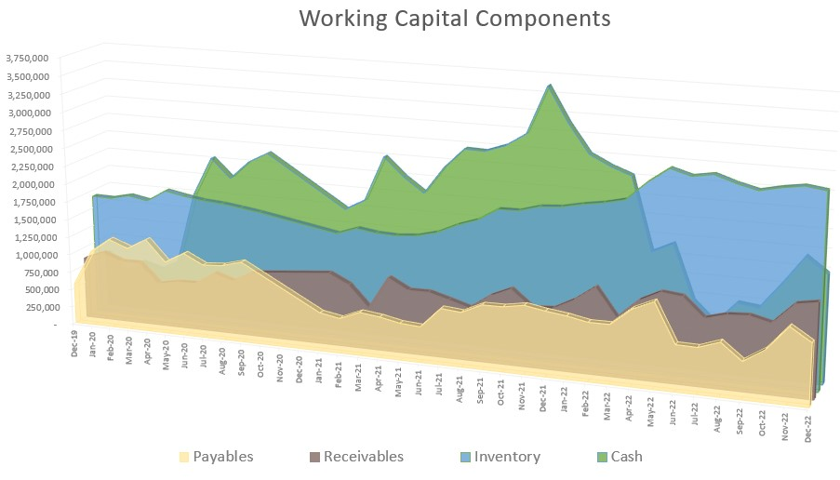
ACCOUNTING PRINCIPLES: PREPARING FOR GOVERNMENT CONTRACTING
A Working Capital chart helps you identify your financial health including:
Cash
Line of Credit balance
Accounts receivable
Accounts payable
Inventory

Slide 27

ACCOUNTING PRINCIPLES: PREPARING FOR GOVERNMENT CONTRACTING
Build Your Advisory Team
CPA
Banker
Insurance Broker
Bonding –Surety
Attorney
Software Consultant
Payroll Service
401k Third Party Administrator
Financial Advisor

Slide 28

ACCOUNTING PRINCIPLES: PREPARING FOR GOVERNMENT CONTRACTING
Common Mistakes or Pitfalls
Going it alone/DIY
Forgetting to track reimbursable expenses
Not properly registering or licensing with all required agencies
Not properly classifying employees
Not recording payroll entries timely
Not reconciling the books with the bank statement at least monthly
No backup for disbursements, not saving receipts of less than $75
Paying for things in cash and not keeping clear trail or supporting documentation of expenses
Poor categorization or overcategorization in the GL Chart of Accounts

Slide 29
Washington State Agencies
Washington Secretary of State
Department of Labor & Industries
Washington State Department of Revenue
Department of Employment Security

Slide 30

ACCOUNTING PRINCIPLES: PREPARING FOR GOVERNMENT CONTRACTING
Resources
American Public Works Association (APWA)
Master Builders Association (MBA)
Trade Associations
Associated Builders and Contractors (ABC)
Associated General Contractors (AGC)
SWCA
PNSFA

Slide 31

ACCOUNTING PRINCIPLES: PREPARING FOR GOVERNMENT CONTRACTING
Resources Continued
Columbia River Economic Development Council (CREDC)
Washington APEX Accelerator
Greater Vancouver Chamber of Commerce Business Owners
Service Corp of Retired Executives (SCORE)
Association of Washington Business (AWB) Initiatives
Municipal Research and Services Center (MRSC) Rosters
Small Business Development Center (SBDC)

Slide 32

Questions?
EMAIL
tpetrie@perkinsaccounting.com
alex@barrett-cpa.com
PHONE
Teresa: 503 276 1487
Alex: 360 210 5100

Slide 33



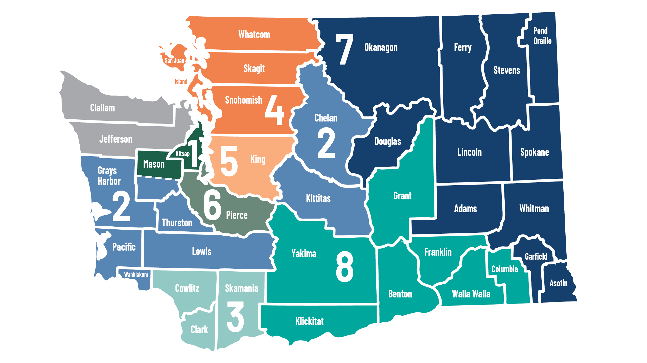





Other APEX Accelerators Serving Washington State
1 Kitsap Economic Development Alliance
  Mary Jo Juarez, Terry Homburg, James Davis
North Olympic Peninsula
APEX Accelerator:
Rebekah Miller
ptac@clallam.org
American Indian Chamber
Education Fund PTAC:
Jeremy Sandoval
Jeremy.sandoval@aicccal.org
NW Native Apex Accelerator:
Chuck Jehle
cjehle@nnapex.org
2 Thurston Economic Development Council
  Grady Smith
Innovation & SBIR Program Manager
Kate Hoy innovationstation@washingtonapex.org
3 Columbia River Economic Development Council
  Julia Krivoruk
4 Economic Alliance Snohomish County
  Cara Buckingham, Mark Johnson
5 Green River College
  Darrell Sundell, Melinda Martirosian
6 Washington APEX Accelerator in Pierce County
  Trena Payton, Maryam Lynch-Tate
7 Greater Spokane Incorporated
  Aleesha Roedel
See full staff listing at washingtonapex.org/about-apex/staff
8 Tri-City Regional Chamber of Commerce
  Maria Alleman
360.860.6945 info@washingtonapex.org washingtonapex.org
Notes:
This is a editable map.
MUST have all fonts installed on your computer to see it properly.

Slide 34



Upcoming Workshops: Preparing for Public Projects w/The Interstate Bridge

Slide 35




Save the date:
May 9th 1PM – 4 PM
Meet the Agencies
Public Works Panel
Hear from & meet Agencies: City of Vancouver, Clark County, C-Tran, Port of Vancouver, IBR, MRSC, and more!

Slide 36
Thank you for attending!
WashingtonApex.org

