Slide 2
ABOUT US
Sharon Harvey, Acting Director of Policy
Lee Lim, Public Works Small Business Enterprise Supervisor

Slide 3
OMWBE Purpose
To be a vital and trusted resource for businesses owned by minorities, women and other under-represented communities to gain access, visibility, and contracting opportunities in procurement.
We work to promote equity in how Washington State spends its resources in the private sector by eliminating barriers to equitable participation in public spending and contracting.

Slide 4
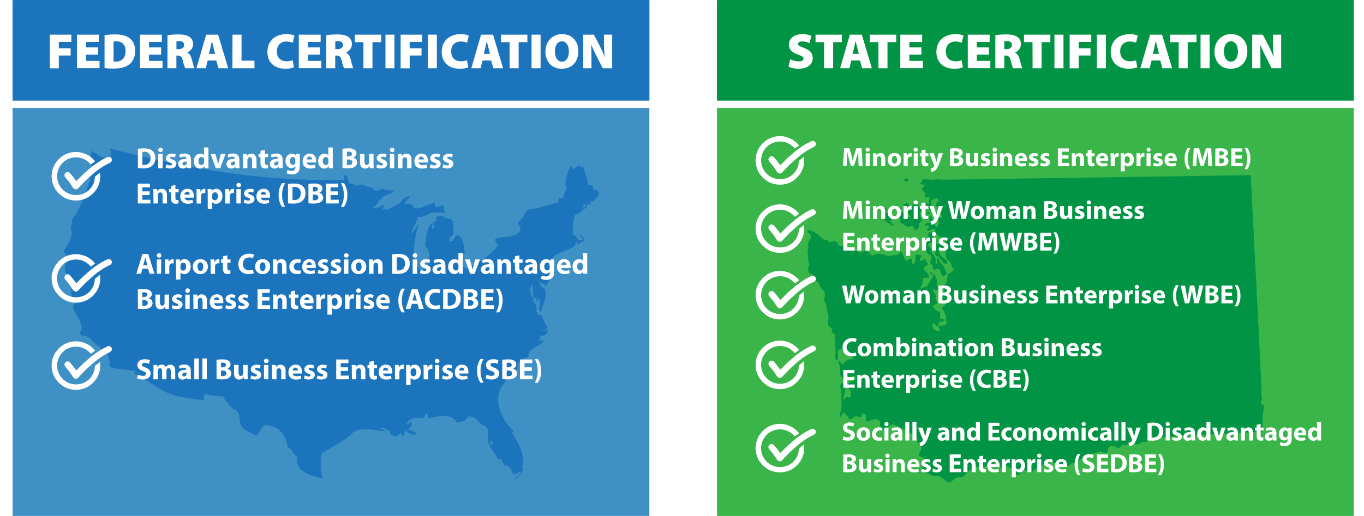
CERTIFICATION Types
PWSBE Certification is Coming Soon!

Slide 5
Public Works Certification
Public Works Small Business Enterprise (PWSBE)
State Certification
Race and Gender Neutral
Eligibility Requirements
Personal Net Worth (PNW) under $1.32 million excluding primary residence and applicant business
Gross Receipts Under $30.4 million based on a 3-year average
Public works focused – Public work means all work, construction, alteration, repair, or improvement. Ex: Public buildings, infrastructure

Slide 6
PWSBE Certification
PWSBE businesses may be placed on the statewide small works roster by the Municipal Research and Services Center (MRSC)
OMWBE state certified businesses operating in public works are automatically PWSBE eligible at no additional cost
Direct contracting opportunities

Slide 7
Why Get Certified?
Why Get Certified?
Your firm anticipates working with state agencies, local governments, school districts, and public universities.
Direct Contract opportunity with state agencies and local governments.
State agencies and colleges have supplier diversity goals.
Some private companies also use OMWBE’s certified businesses to fulfill their supplier diversity goals.

Slide 8
Benefits
Increase your visibility through listings on important databases for certified businesses and active bids throughout the state including WEBS
Listed on OMWBE’s public directory
Direct contracting opportunity when 6 or more certified businesses are on statewide small works roster
Small Business Assistance support services to navigate your certification
Use our logo on your business website
GROW YOUR BUSINESS!

Slide 9
TYPES OF
Documents
Affidavit of Certification
Personal and Business Taxes (3 Years)
Personal Net Worth Statement
Business Formation and Operating Documents
Resume(s)
Proof of Initial Investment
List of Equipment

Slide 10
Application Process Time
Application Process Time
UP TO
90 DAYS FOR
FEDERAL
CERTIFICATION
*Federal Certification Requires and Onsite Visit
UP TO
60 DAYS FOR
STATE
CERTIFICATION

Slide 11
CERTIFICATION
Application
Where do I start my certification application?
CREATE AN ACCOUNT ON THE CERTIFICATION PORTAL
Visit omwbe.diversitycompliance.com
“Apply For / Renew Certification” | “Create Account”
ONLINE APPLICATION
Choose State or Federal. Start a federal application if you want both state and federal certifications.
COMPLETE ONLINE APPLICATION AND UPLOAD DOCUMENTS

Slide 12
Questions?
Sharon Harvey, Acting Director of Policy
Email: SharonH@omwbe.wa.gov
Phone: (360) 704-8437
Lee Lim, PWSBE Supervisor
Email: LeeL@owmbe.wa.gov
Phone: (360) 890-6305
Office of Minority & Women’s Business Enterprises
1110 Capitol Way S #150, Olympia, WA 98501
Phone: (360) 664-9750 | omwbe.wa.gov

